Slide 1
Sen-220 software engineering
AGILE DEVELOPMENT

Slide 2
WHAT IS AGILITY?
Agility has become today’s buzzword when describing a modern software process.
Everyone is agile. An agile team is a nimble team able to appropriately respond to changes. Change is what software development is very much about. Changes in the software being built, changes to the team members, changes because of new technology, changes of all kinds that may have an impact on the product they build or the project that creates the product.
Support for changes should be built-in everything we do in software, something we embrace because it is the heart and soul of software.
An agile team recognizes that software is developed by individuals working in teams and that the skills of these people, their ability to collaborate is at the core for the success of the project.

Slide 3
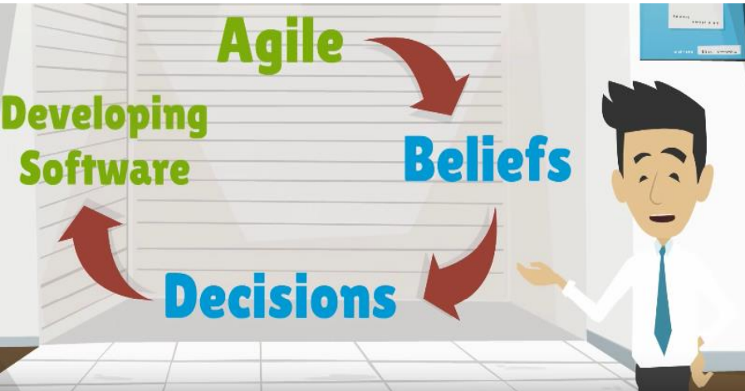
What is agile?
Agile is really a collection of beliefs that teams can use for making decision about how to do the work of developing software.
Agile is flexible. It doesn’t make decisions for you. Instead, it gives a foundation for teams to make decisions that result in better software development.

Slide 4
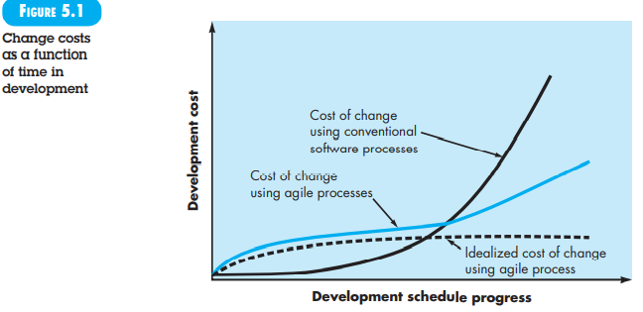
AGILITY AND THE COST OF CHANGE

Slide 5
WHAT IS AN AGILE PROCESS?
Any agile software process is characterized in a manner that addresses a number of key assumptions about the majority of software projects:
It is difficult to predict in advance which software requirements will persist and which will change. It is equally difficult to predict how customer priorities will change as the project proceeds.
For many types of software, design and construction are interleaved. That is, both activities should be performed in tandem so that design models are proven as they are created. It is difficult to predict how much design is necessary before construction is used to prove the design.
Analysis, design, construction, and testing are not as predictable (from a planning point of view) as we might like.

Slide 6
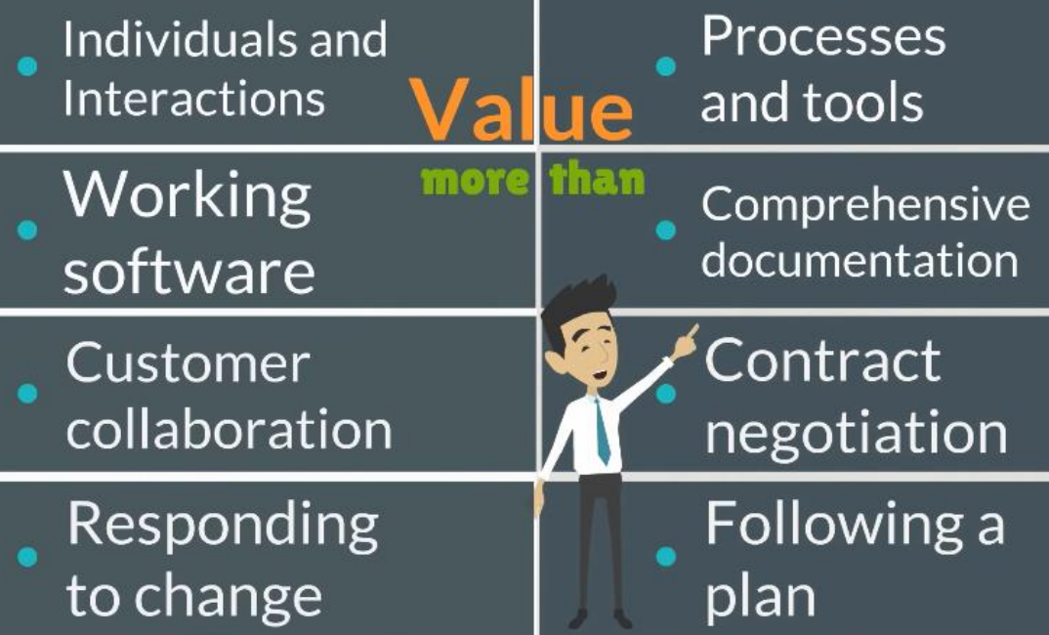
Agile manifesto
Agile manifesto is only 68 words and very simply says that we can develop software better by valuing the items on the left side of the list more than the items on the right side.
In addition to the values of the manifesto, there are 12 principles that support the values.

Slide 7
Agility principles
The Agile Alliance defines 12 agility principles for those who want to achieve agility:
Our highest priority is to satisfy the customer through early and continuous delivery of valuable software.
Welcome changing requirements, even late in development. Agile processes harness change for the customer's competitive advantage.
Deliver working software frequently, from a couple of weeks to a couple of months, with a preference to the shorter timescale.
Business people and developers must work together daily throughout the project.
Build projects around motivated individuals. Give them the environment and support they need, and trust them to get the job done.
The most efficient and effective method of conveying information to and within a development team is face-to-face conversation.

Slide 8
Agility principles
Working software is the primary measure of progress.
Agile processes promote sustainable development. The sponsors, developers, and users should be able to maintain a constant pace indefinitely.
Continuous attention to technical excellence and good design enhances agility.
Simplicity—the art of maximizing the amount of work not done—is essential.
The best architectures, requirements, and designs emerge from self-organizing teams.
At regular intervals, the team reflects on how to become more effective, then tunes and adjusts its behavior accordingly.
Not every agile process model applies these 12 principles with equal weight, and some models choose to ignore (or at least downplay) the importance of one or more of the principles. However, the principles define an agile spirit that is maintained in each of the process models.

Slide 9
How does a team become Agile?
The decision making process is how a team becomes agile. The values have enough flexibility to allow teams in a wide variety of organizations to develop softwares in the ways that work best for their particular situation while providing enough direction to help a team continually move towards their full potential.

Slide 10
What is Scrum in AGILE?
Scrum is a framework of rules, roles, events, and artifacts used to implement Agile projects. It is an iterative approach, consisting of sprints that typically only last one to four weeks. This approach ensures that your team delivers a version of the product regularly.
Scrum was designed using a software model that follows a set of roles, responsibilities, and meetings. It can be used for any complex project but works best when the result is a concrete product rather than a service.

Slide 11
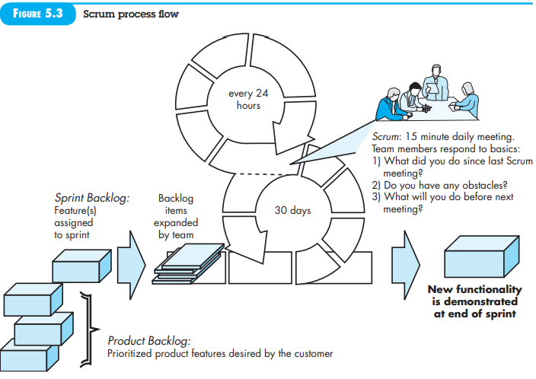

Slide 12
What is Scrum in AGILE?
Scrum in Agile requires particular roles and responsibilities, including the following:
Product owner: The product owner is responsible for representing the customer’s best interest. This person has the ultimate authority over the final product.
Scrum master: This person is a facilitator, responsible for arranging the daily meetings, improving team interactions, and maximizing productivity. The project manager often takes on the role of Scrum master, but they can delegate it to anyone on the team who is a Scrum expert and strong facilitator.
Backlog: The backlog is a list of tasks and requirements included in the final product. It’s the responsibility of the product owner to create the backlog.
Sprint: A sprint is a set time frame for completing each set of tasks from the backlog. Every sprint should be the same length. Two weeks is typical, but a sprint can be anywhere between one to four weeks long, depending on the team and project’s needs.
Daily meetings: A Scrum project team is expected to meet every day to discuss progress. These meetings are typically referred to as a Daily Scrum or Daily Stand-Up.
Retrospective: Each sprint should end with a review meeting, called a retrospective. Here, the team reviews their progress and discusses how they can improve in the next sprint.

Slide 13
KANBAN
Agile Kanban is Agile Software Development with Kanban approach. In Agile Kanban, the Kanban board is used to visualize the workflow.
The Kanban board is normally put up on a wall in the project room. The status and progress of the story development tasks is tracked visually on the Kanban board with flowing Kanban cards.

Slide 14
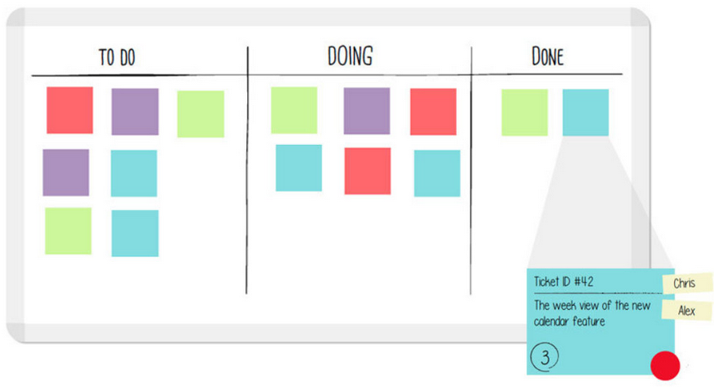
Kanban board
Kanban board is used to depict the flow of tasks across the value stream. The Kanban board −
Provides easy access to everyone involved in the project.
Facilitates communication as and when necessary.
Progress of the tasks are visually displayed.
Bottlenecks are visible as soon as they occur.

Slide 15
Advantages of kanban
The major advantages of using a Kanban board are −
Empowerment of Team − This means −
Team is allowed to take decisions as and when required.
Team collaboratively resolves the bottlenecks.
Team has access to the relevant information.
Team continually communicates with customer.
Continuous Delivery − This means −
Focus on work completion.
Limited requirements at any point of time.
Focus on delivering value to the customer.
Emphasis on whole project.

Slide 16
Kanban board
The tasks and stories are represented by Kanban cards. The current status of each task is known by displaying the cards in separate columns on the board. The columns are labeled as To Do, Doing, and Done. Each task moves from To Do to Doing and then to Done.
Kanban Board is updated on a daily basis as the team progresses through the development.
WIP Limit
The label in the Doing column also contains a number, which represents the maximum number of tasks that can be in that column at any point of time. i.e., the number associated with the Doing column is the WIP (Work-In-Progress) Limit.
Pull Approach
In the pull approach of Kanban, work is like a three-step dance:
To Do: Work items wait here until someone is ready to work on them. It's like waiting for your turn in line.
Doing: When a team member is available, they pull a task from the "To Do" column into the "Doing" column. It's like saying, "I'm ready now."
Done: After completing the task, it's moved to the "Done" column. This represents successful completion.
So, work is only done when someone is ready for it, not when it's pushed onto them. This keeps things flowing smoothly.

Slide 17
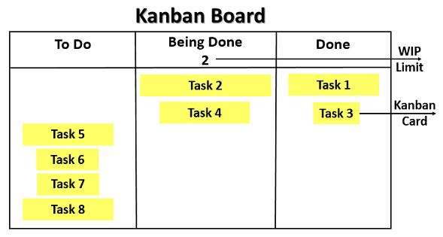

Slide 18
Kanban board
Self-directing
In Agile Development, the team is responsible for planning, tracking, reporting and communicating in the project. Team is allowed to make decisions and is accountable for the completion of the development and product quality. This is aligned to the characteristic of empowerment of the team in Kanban.
Continuous Flow
In Agile development, there is no gate approach and the work flows across the different functions without wait-time. This contributes in minimizing the cycle time characteristic of Kanban.
Visual Metrics
In Agile Kanban, the metrics are tracked visually using −
Kanban Board
Burndown Chart

Slide 19
What is a burndown chart?
What is a burndown chart? In a nutshell, it’s a project management tool that PMs use to help their teams forecast, view, and track project process.
What is burn rate in Agile? A project burndown chart (also known as a project burn rate chart or PERT chart) is a graph that shows how many project tasks are left to finish during a selected time period. Teams use it to keep track of progress and to visualize forecasting. The x-axis of the chart shows the amount of time (in days, weeks, or months) and the y-axis shows the number of tasks (or labor, in estimated hours).
It’s called “burndown” because it’s expected that your tasks will decrease as the project goes on, creating a literal downward line on the chart as your team “burns” through project activities. This is, of course, under ideal circumstances with limited disruptions or backlog, which is why this graph line is called the ideal line.

Slide 20
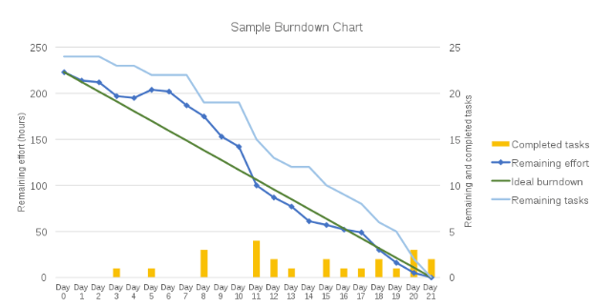
What is a burndown chart?

